Slide 1


Personal Brand & Big Data
Santiago de Compostela
Octubre 2017

Slide 2


conectar a los profesionales del mundo para ayudarles a aumentar su productividad y rendimiento.
Notes:
"All the world's professionally relevant knowledge lives within the minds of our members"
Something our CEO says regularly and that we firmly believe
Part of our vision is to build products and solutions that help "unlock" that knowledge and make it more accessible for everyone
Ultimately this helps support our mission to make the worlds professionals more productive and successful
One important way in which knowledge is spread is when members (or employees) share it with their networks.
We've always known this benefits members -- in connecting with their networks, building their professional brands and encouraging information exchange with others...but we've also known (and recently proven with data) that when employees share knowledge it helps
make the companies they work for more successful as well

Slide 3
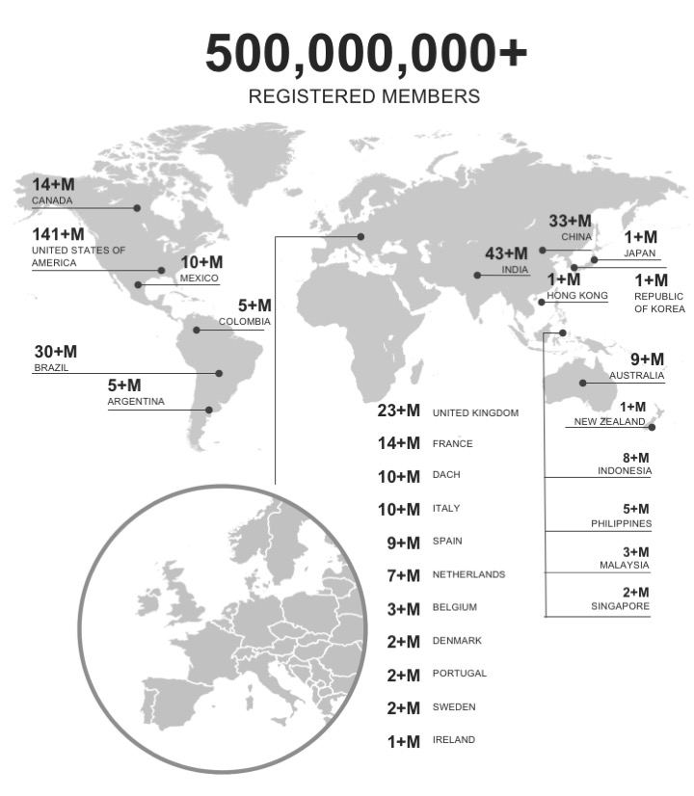
Regional membership
162+M EMEA
141+M USA
123+M Asia and the Pacific
72+M LATAM

Slide 4



2
+2
+2
+2
+2
+2
+2
+2
+2
+2
+2
+2
+2
+2
+2
+2
+2
+2
+2
+2
+2
+2
+2
+2
+2
+2
+2
+2
+2
+2
+2
+2
+2
+2
+2
+2
+2
+2
+2
+2
+2
+2
+2
+2
+2

Slide 5







The Economic Graph
Members
companies
jobs
skills
schools
knowledge

Slide 6
The Economic Graph
500m
Members
7m
companies
5m
jobs
3b
Endorsements
for 45K+ skills
27K
schools
300k
Daily posts

Slide 8



LinkedIn ayuda a sus usuarios
IDENTIDAD
CONECTAR
ENCONTRAR
OPORTUNIDADES
ESTAR INFORMADO
Notes:
Our value propositions for members – three ways that LinkedIn helps its members

Slide 9




Slide 10


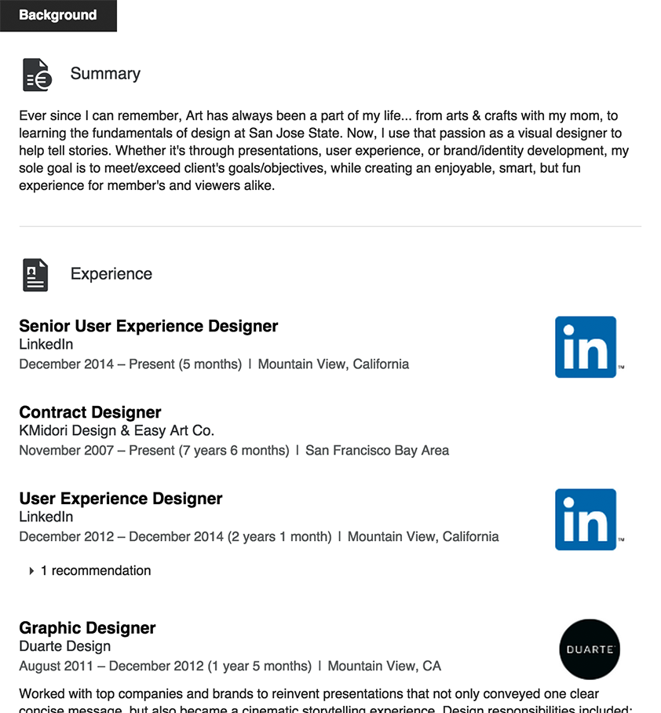
Añade una foto profesional
1
14x
Se obtienen hasta 14 veces más visitas en tu perfil si tienes fotografía
Notes:
Select a photo that represents you professionally. This helps humanize your profile and makes you more approachable. You don’t have to enlist the help of a professional photographer – ensure you’re dressed professionally and alone in the shot and you can even take a photo with the help of a colleague.

Slide 11


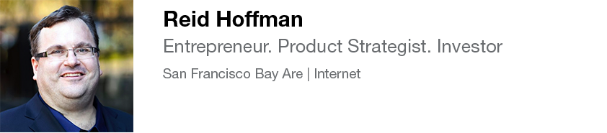
Escribe un titular que llame la atención
2
Explica lo que haces.
Muestra tu pasión y qué te diferencia
Notes:
Your profile is the front page of your story. The headline is a great way to show your value and passion in one quick line. Inspire the viewer to read more.

Slide 12
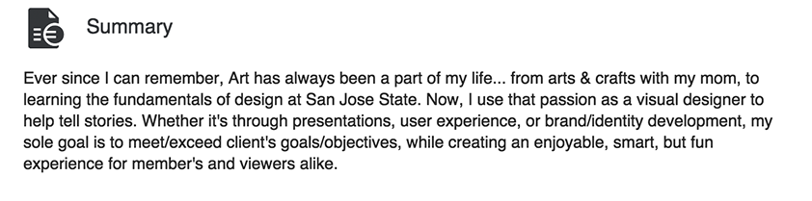
Crea un extracto sencillo y descriptivo
3
Céntrate en tus logros profesionales y en tus aspiraciones.
Al menos 40 palabras.
Incluye palabras clave en tu carrera
(no palabras muy manidas/vacías)
Notes:
Adding a summary of 40 words or more makes your profile more likely to turn up in a future employer’s search. A good tip is to ensure your summary includes keywords featured in desirable job descriptions for your field. Describe your experience and tell the world why you work in your chosen career. Avoid buzzwords (examples: strategic, team player, creative) and focus on your career accomplishments.

Slide 13
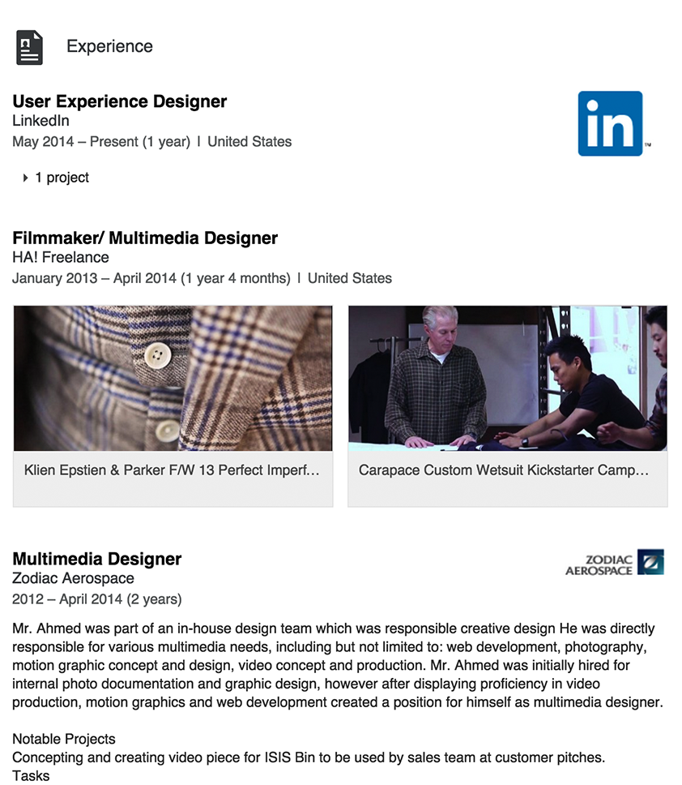
Detalla tu experiencia profesional en diferentes etapas.
4
12x
Recibirás hasta 12 veces más visitas a tu perfil completando tu experiencia.
Notes:
It’s essential to list all past experience. Your profile is 12 times more likely to be viewed if you have more than one position listed.

Slide 14

Añade ejemplos gráficos de tu trabajo (fotografías, presentaciones, videos…)
5
Proporciona una experiencia dinámica, más visual, que represente mejor tu historia profesional.
Notes:
Illustrate your unique professional story and achievements by adding visuals such pictures, compelling videos, links to news stories and innovative presentations to your experience section.

Slide 15
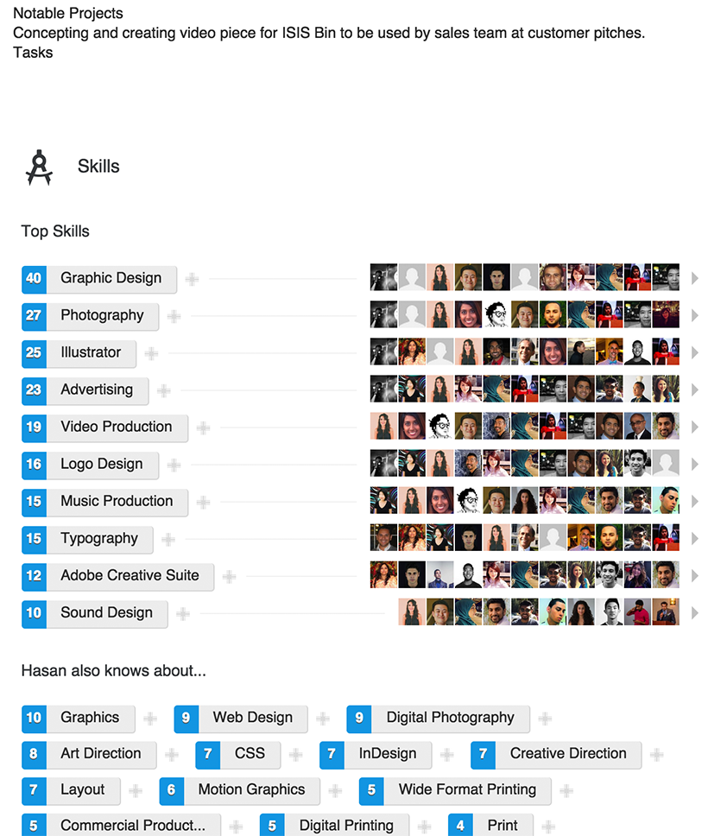
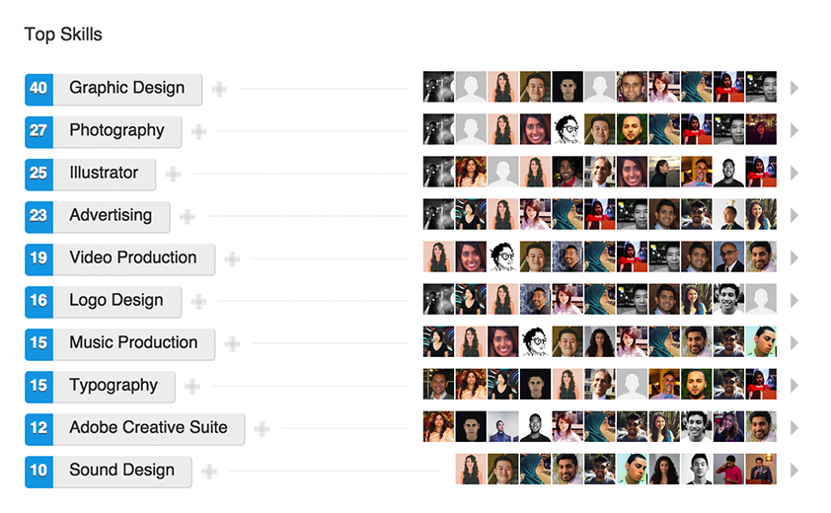
Añade tus habilidades y recibe recomendaciones.
6
Incluye una mezcla entre tus habilidades a alto nivel y las más generales.
Notes:
Add skills – The optimal number is unique to each person. Include a mix of high level and niche skills and be specific.
Get Endorsements -Add skills that your connections can endorse you for and recognize those you’ve worked with on their professional skills. There are over 3 billion endorsements given to date on LinkedIn.

Slide 16
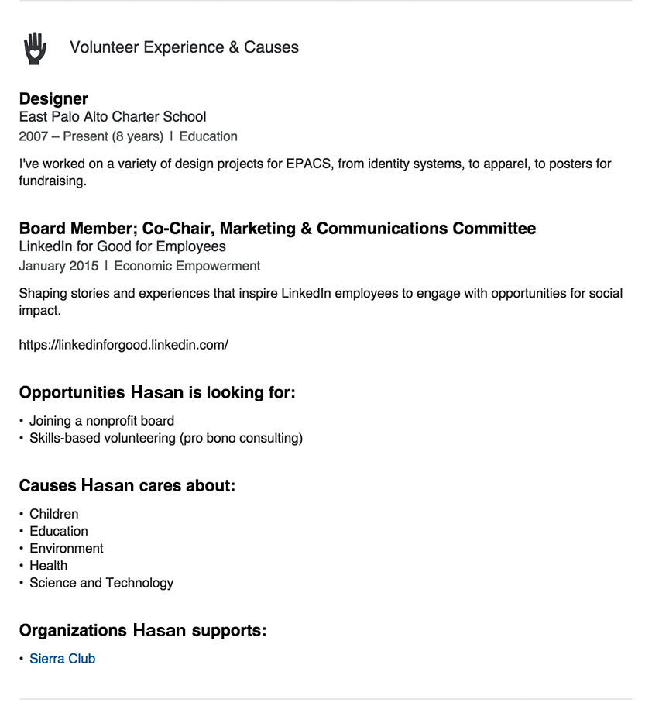
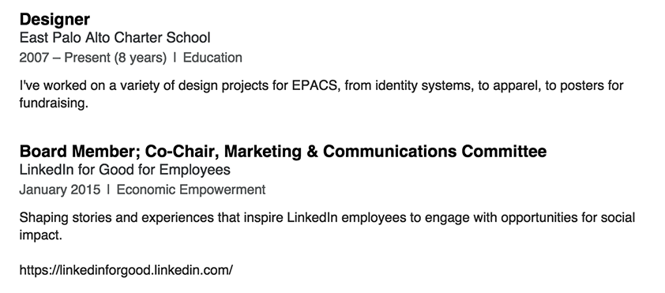
Incluye tu experiencia como voluntario y en otras causas benéficas
7
6x
Más visitado. ¡El contenido se comparte!
Notes:
Adding causes and volunteer experience is a great way to round out your professional identity. Almost half of all hiring managers say they view volunteer experience as equivalent to formal work experience.

Slide 17
MANTENTE AL DÍA
Construye tu marca profesional

Slide 18
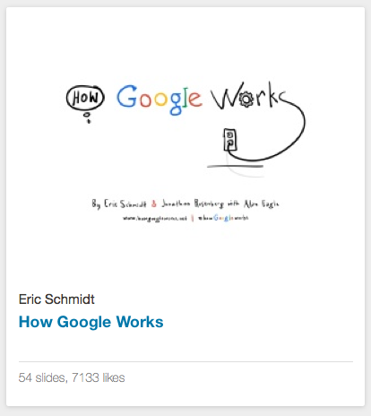

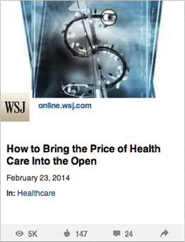
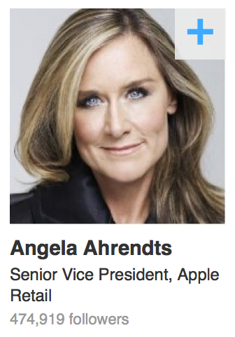
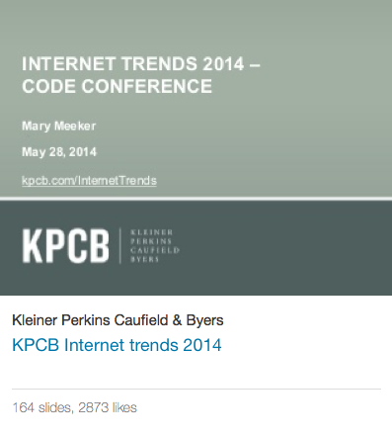
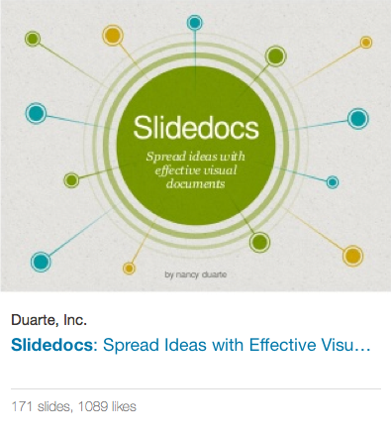


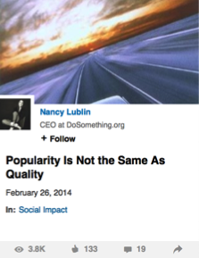

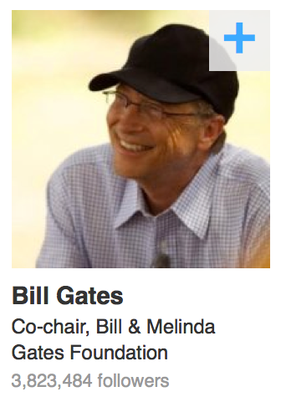
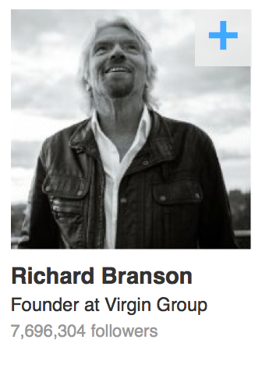




Las noticias y el conocimiento profesional más relevante para tu carrera
SlideShare
Grupos
Noticias en Pulse
Influencers & Publishing
Notes:
There are many ways for your to share what you know on LinkedIn, and to also learn from others who are sharing their expertise. I am going to dive deeper into a couple of these.
SlideShare – upload you presentations, or infographics. New functionality now where you can with one click from SlideShare, add a presentation to your LinkedIn profile
Groups – We have over 2.1M groups on LinkedIn – connect with other professionals with similar interests to you. Collaborate, share, discuss
Pulse – Consume content on the topics that interest you.
Influencers – Follow industry influencers
We also have member publishing, which hopefully you’ve heard of. We’re going to dive deeper into that in a little bit.

Slide 19
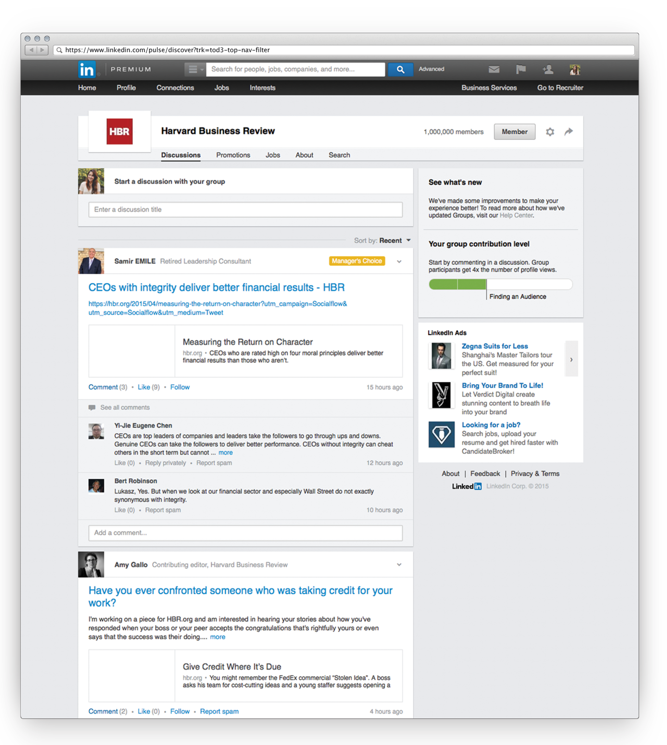
Encuentra y únete a los GRUPOS que te interesan
Participa en las novedades
de tu industria
Notes:
Look for groups relating to your industry, function, and career interest –– then join a few to stay up to date on trending topics and news. Build a solid professional reputation by sharing your ideas and commenting on others’ posts and providing advice where appropriate.

Slide 20
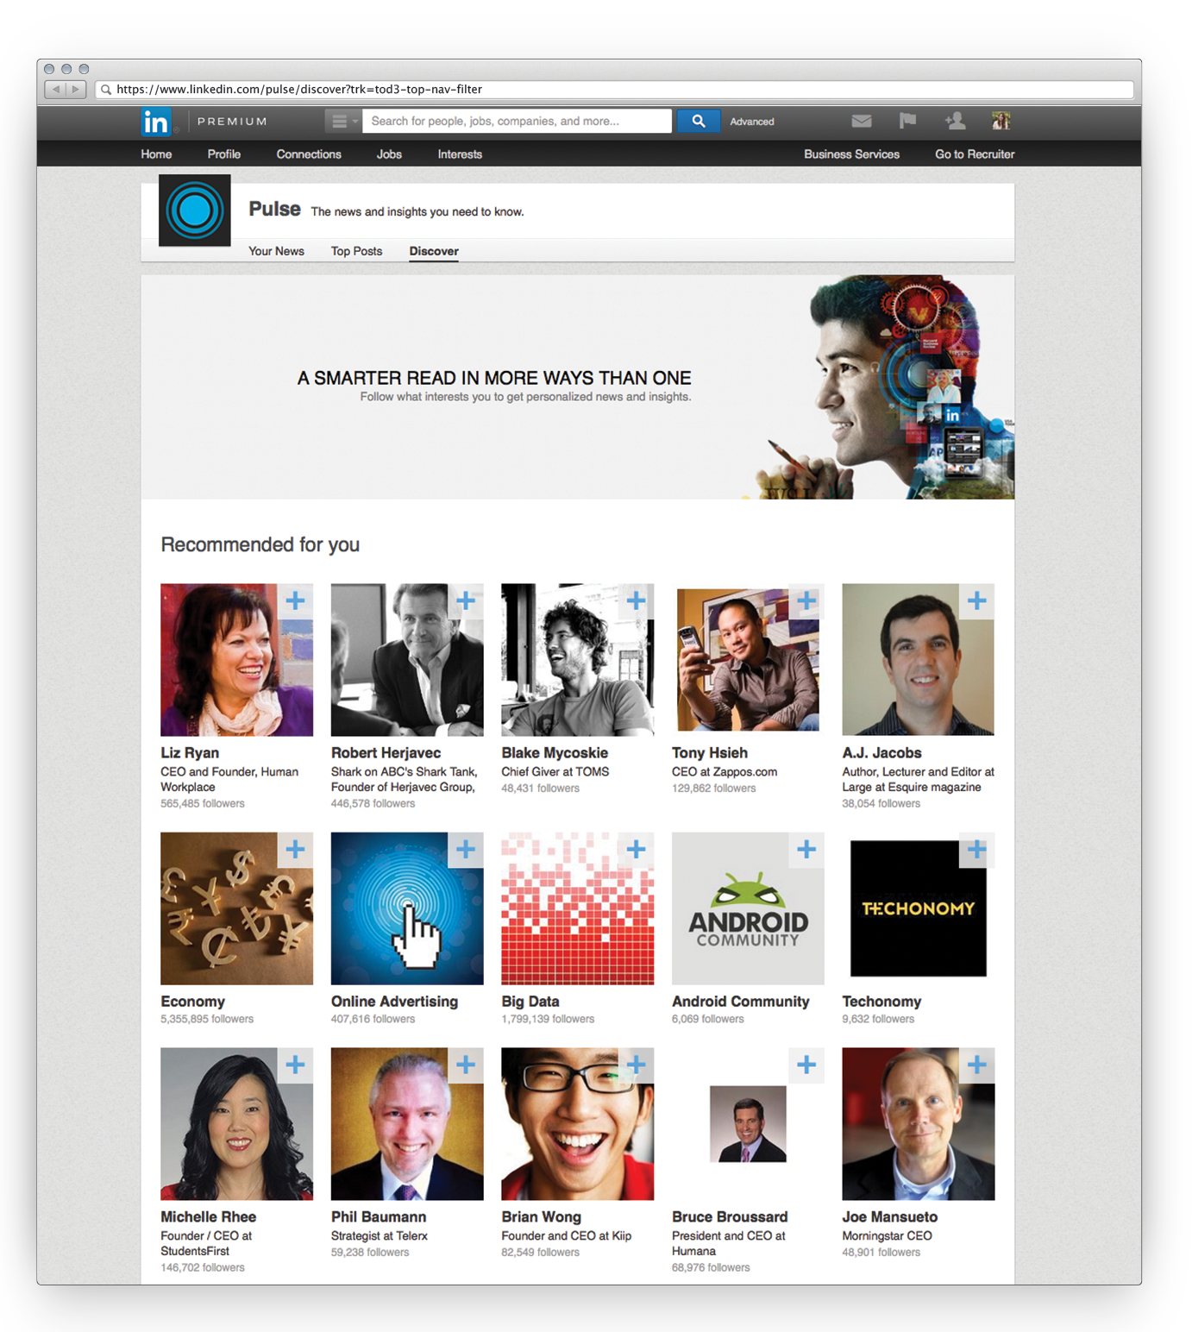
Descubre los contenidos que realmente te interesan en tu carrera
Construye y desarrolla tu conocimiento
Notes:
Keep up to date on industry news and articles on LinkedIn that will make you better at the job you have now.

Slide 21
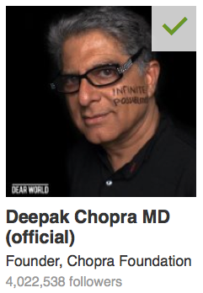
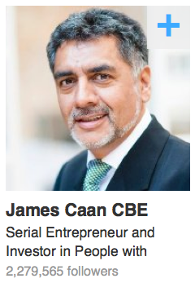
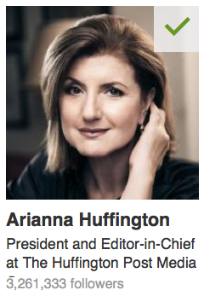
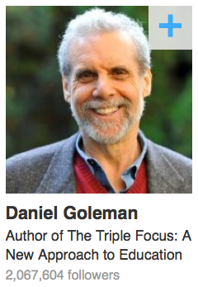
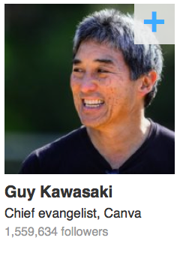
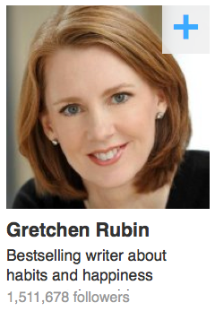
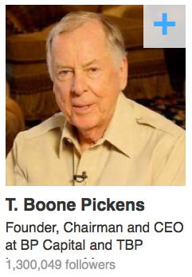
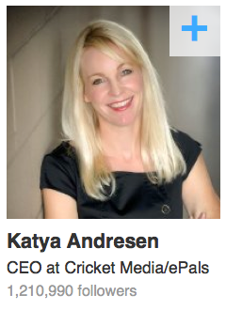
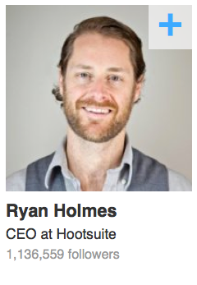
Sigue y aprende con los líderes de cada industria

Slide 22
Compartir noticias y publicar contenidos
La manera de crecer en tu red desde el conocimiento
NOTICIAS
PUBLICACIONES
Comparte links, artículos, imágenes, frases o cualquier otro contenido que pueda interesar a tu red.
Explora con profundidad las materias que realmente te interesan en tu carrera. Aprende a través de tu red, sus comentarios y sus aportaciones.

Slide 23
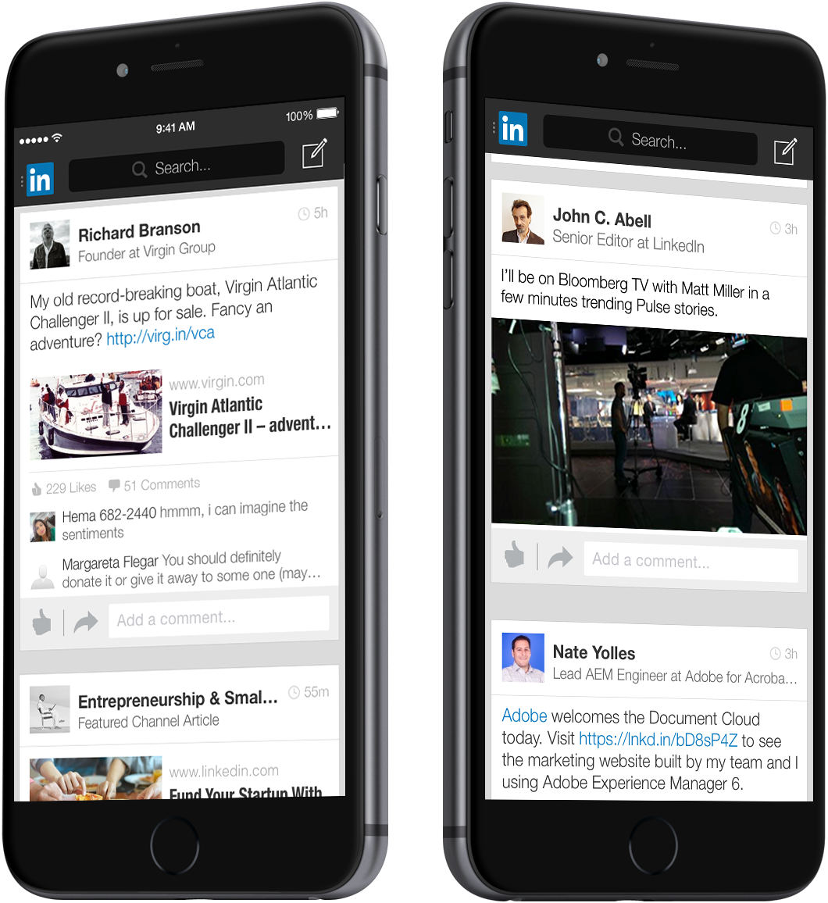
Comparte tu conocimiento, tu perspectiva y lo que te importa a través de updates
Haz crecer tu alcance y relevancia
Notes:
Grow your reach: Writing on LinkedIn is a great way to tap into and grow your network. Not only will your posts reach your connections, you can also build a following

Slide 24

Publicando en LinkedIn: estar y saber estar
Se convierte en parte de tu perfil
Compartes con una red de calidad
Alcanzas oportunidades y redes en todo el planeta

Slide 25
Empleos
8x
Se obtiene 8 veces más interacción con contenidos que con ofertas de empleo.
Contenido
Notes:
The usage of our platform has dramatically shifted and content now gets 7x more engagement than jobs on LinkedIn. Today, we are the definitive platform for professionals to gain and share content and insights.

Slide 26

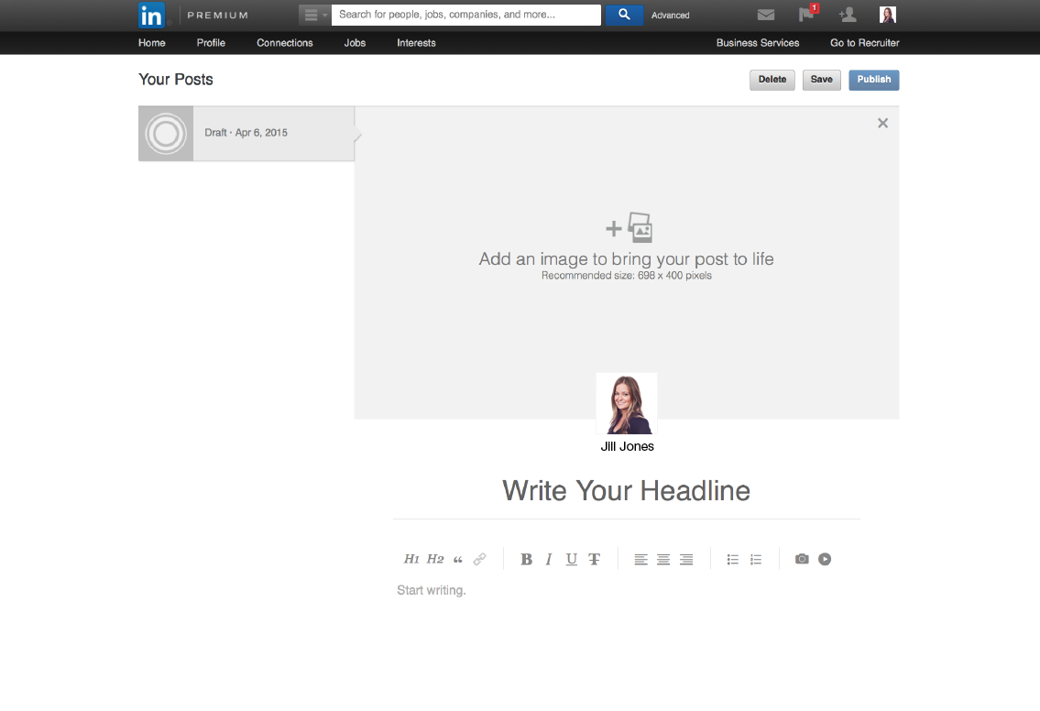
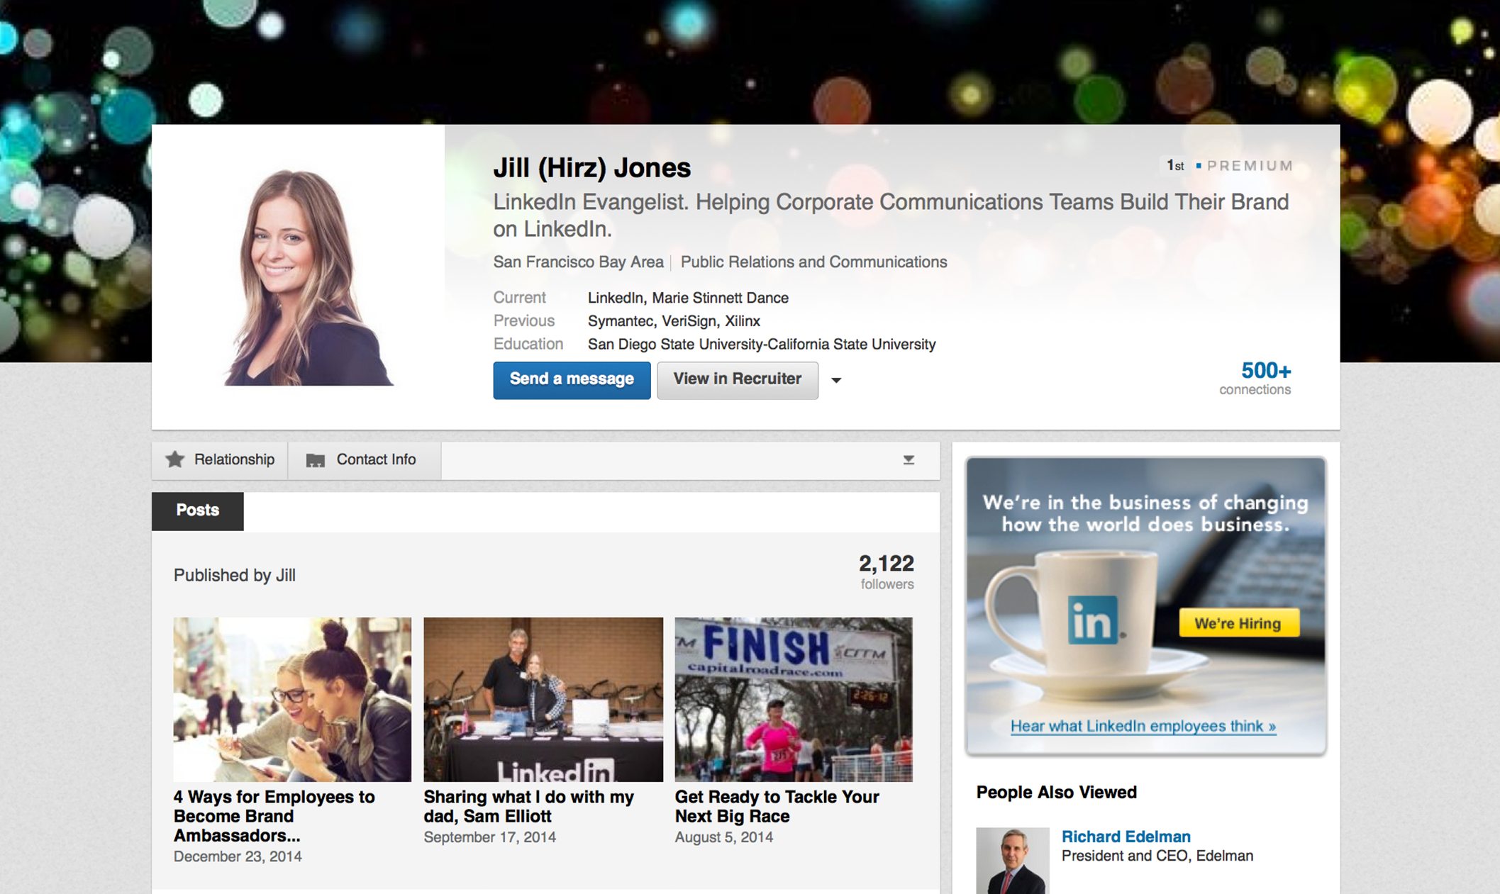
Sé conocido y reconocido por lo que haces y lo que aportas
Refuerza tu reputación y haz crecer tu alcance y relevancia profesional.

Slide 28


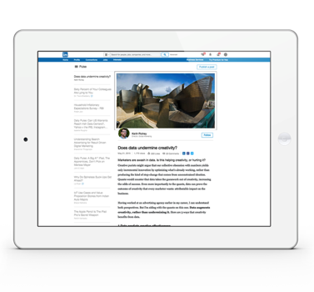

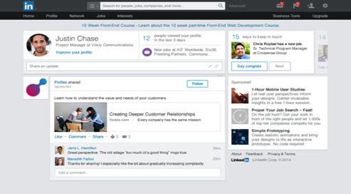
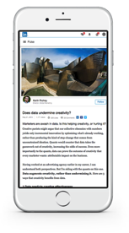
22%
33%
45%
20%
35%
45%

Slide 29
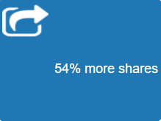
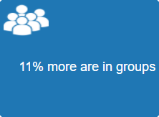
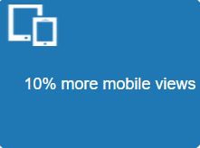
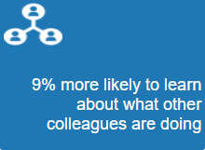
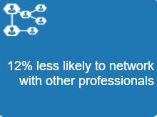
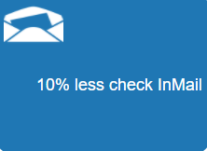
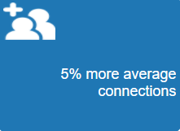
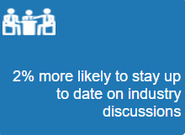

Slide 30


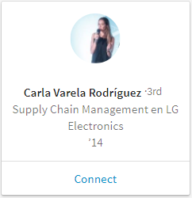
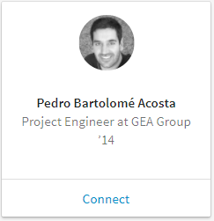
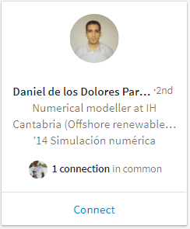
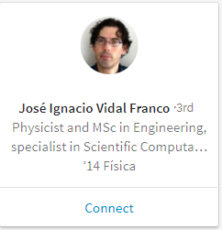
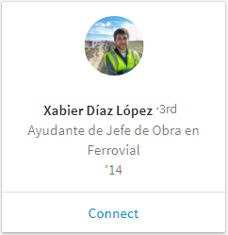
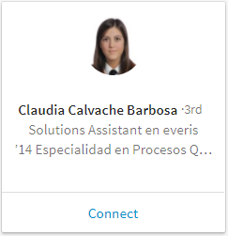
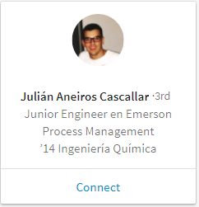
179
Ingeniería
en 2015
91%
Trabajan
en España
78%
Trabajan
en Galicia
Notes:
This slide is customized to the audience you selected.

Slide 31

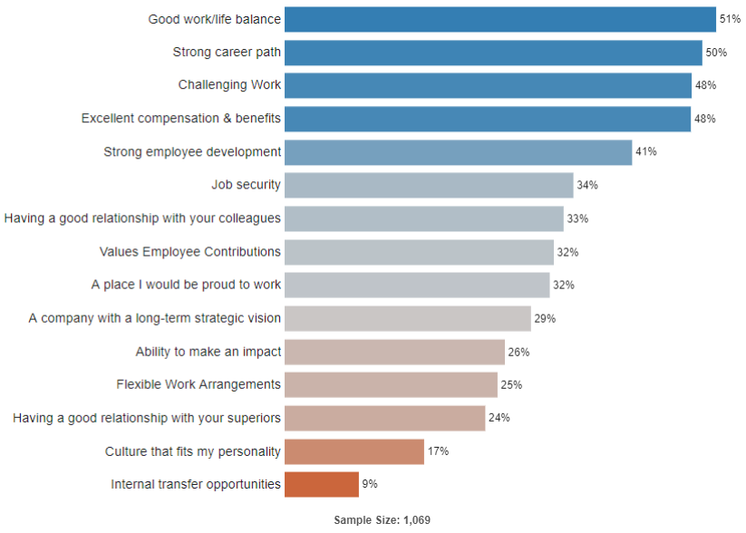



DATA?? … What for??
Engineering / Spain / 1-2 year exp.
Notes:
This slide is customized to the audience you selected.

